Slide 1




Floor | Base | Roof | Total
1 | 0 | 2 | 2
2 | 1 | 6 | 7
3 | 3 | 12 | 15
4 | 6 | 20 | 26
5 | 10 | 30 | 40
1
2
F: Floor B: Base R: Roof T:Total
B =
3
R =
T = B + R =
4

Slide 2
Floor | Base | Roof | Total
1 | 0 | 2 | 2
2 | 1 | 6 | 7
3 | 3 | 12 | 15
4 | 6 | 20 | 26
5 | 10 | 30 | 40
1
2
F: Floor B: Base R: Roof T:Total
Pseudocode-1
f = INPUT “Enter floor count”
CALCULATE b = f X (f-1)/2
CALCULATE r = f X (f+1)
CALCULATE t = b + r
PRINT “Cards needed for ” f “is:”
PRINT b “pieces for Base”
PRINT r “pieces for Roofs”
PRINT t “pieces total”
3
4
Notes:
Python notebook code

Slide 3
Pseudocode-2
SET card_limit = 104 # 2x52 pieces
SET f = 1
SET t = 0
WHILE t <= card_limit
BEGIN
b = f X (f-1)/2
r = f X (f+1)
t = b + r
f = f + 1
END
fm = f – 1
used_cards = (3*fm*fm + fm)/2
remaining_cards = card_limit – used_cards
PRINT “Using ” card_limit “cards”
PRINT “Maximum floor is ” fm
PRINT “Needed card count is” used_cards
PRINT remaining_cards “cards will remain”
1
2
3
4

Slide 4
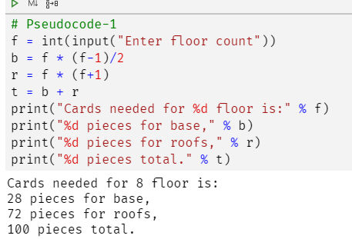
# Pseudocode-1
f = int(input("Enter floor count"))
b = f * (f-1)/2
r = f * (f+1)
t = b + r
print("Cards needed for %d floor is:" % f)
print("%d pieces for base," % b)
print("%d pieces for roofs," % r)
print("%d pieces total." % t)

Slide 5
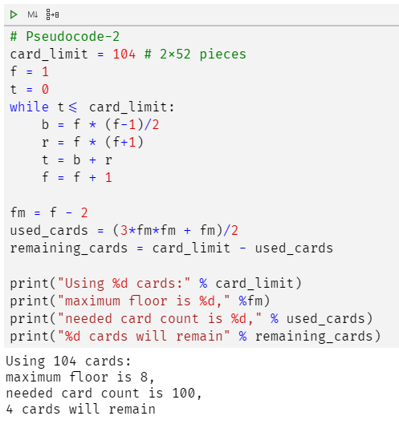
# Pseudocode-2
card_limit = 104 # 2x52 pieces
f = 1
t = 0
while t<= card_limit:
b = f * (f-1)/2
r = f * (f+1)
t = b + r
f = f + 1
fm = f - 2
used_cards = (3*fm*fm + fm)/2
remaining_cards = card_limit - used_cards
print("Using %d cards:" % card_limit)
print("maximum floor is %d," %fm)
print("needed card count is %d," % used_cards)
print("%d cards will remain" % remaining_cards)

